Slide 1

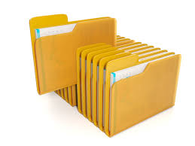
Files

Slide 2
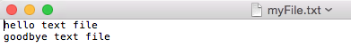
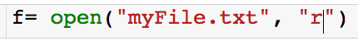
Files
Let’s say I have the following .txt file saved on my computer.
Open file:

Slide 3
Files
Let’s say I have the following .txt file saved on my computer.
Open file:
“r”: read
“w”: write
“a”: append
File path

Slide 4
Files
Let’s say I have the following .txt file saved on my computer.
Open file:
“r”: read
“w”: write
“a”: append
File path

Slide 5
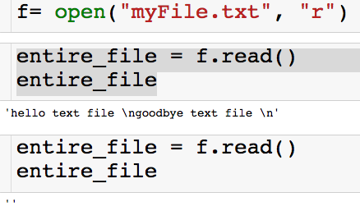
Reading from Files
Read the entire file into a string all at once
read() method:
Everything will be read in as a string

Slide 6
Reading from Files
Read the entire file into a string all at once
read() method:

Slide 7
Reading from Files
Read the entire file into a string all at once
read() method:

Slide 8
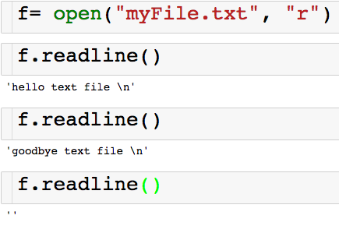
Reading from Files
Read one line at a time
readline() method:

Slide 9
Reading from Files
Read one line at a time
readline() method:

Slide 10
Reading from Files
Read one line at a time
readline() method:

Slide 11
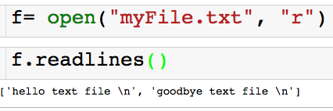
Reading from Files
Read all the lines at one into a list
readlines() method:

Slide 12
Reading from Files
Read all the lines at one into a list
readlines() method:

Slide 13
Reading from Files
Read all the lines at one into a list
readlines() method:
We get a list of strings where each element in the list is a line

Slide 14
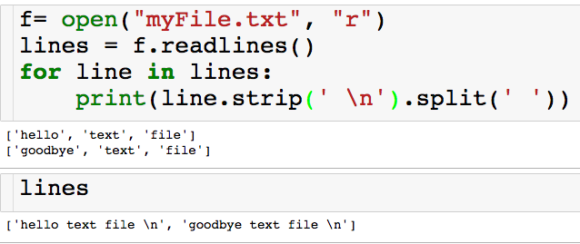
Reading from Files
Read all the lines at one into a list
readlines() method + string methods:

Slide 15
Reading from Files
Read all the lines at one into a list
readlines() method + string methods:

Slide 16
Reading from Files
Read all the lines at one into a list
readlines() method + string methods:

Slide 17
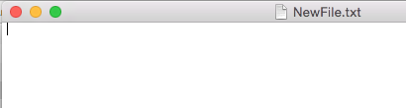
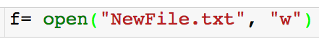
Writing to Files
Writing to files
Open file:
Creates new blank .txt file called “NewFile.txt” that we can then write too.
If this file exists, then it will overwrite it with a blank file…so be careful.

Slide 18
Writing to Files
Writing to files
write() method:

Slide 19
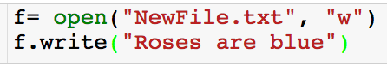
Writing to Files
Writing to files
write() method:
We can only write strings to files

Slide 20
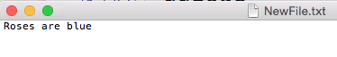
Files
Writing to files
write() method:

Slide 21
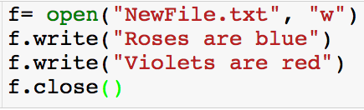
Writing to Files
Writing to files
write() method:

Slide 22
Writing to Files
Writing to files
write() method:

Slide 23
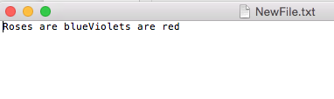
Writing to Files
Writing to files
write() method:

Slide 24
Writing to Files
Writing to files
write() method:
We wanted to print the second line on a new line!

Slide 25
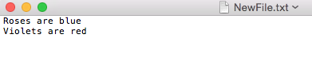
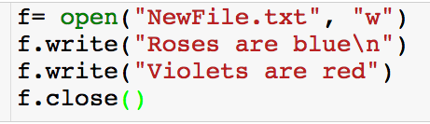
Writing to Files
Writing to files
write() method:
\n = new line

Slide 26
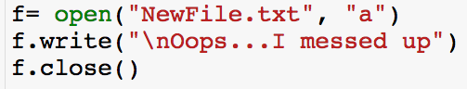
Appending to Files
Appending to a file
write() method:
Will not overwrite like the ‘w’ will.

Slide 27
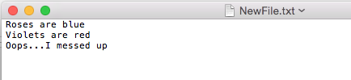
Appending to Files
Appending to a file
write() method:
Will not overwrite like the ‘w’ will.

Slide 28
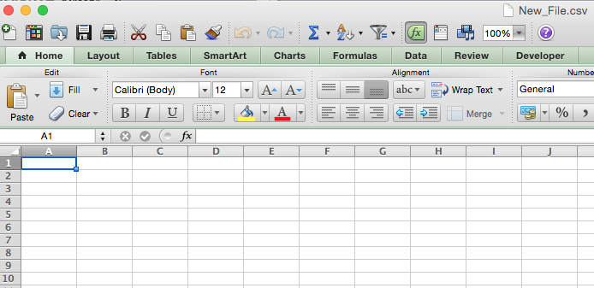
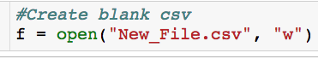
Writing Variables

Slide 29
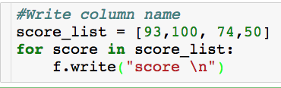
Writing Variables
Always write a string

Slide 30
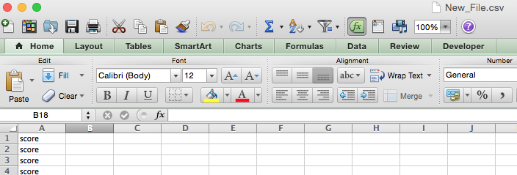
Writing Variables
We write the word score instead of each of the scores!

Slide 31
Formatting String
This leads us to a more general question: How do I place the value of variable (string/float/int) inside of a string?

Slide 32
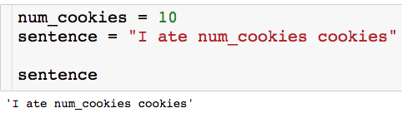
Formatting String
This leads us to a more general question: How do I place the value of variable (string/float/int) inside of a string?
Wanted sentence to be equal to the string “I ate 10 cookies”

Slide 33
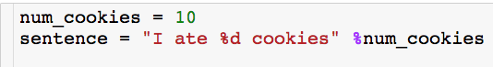
Formatting String - Integers
To format strings:
On the left of the % operator, provide a format string containing one or more embedded conversion targets, each of which starts with a %.
On the right side of the % operator, provide the object (or objects, embedded in a tuple) that you want Python to insert into the format string on the left in place of the conversion targets.
Conversion Targets:
%d = replace with integer
%s = replace with string
%f = replace with float
Variable value to insert

Slide 34
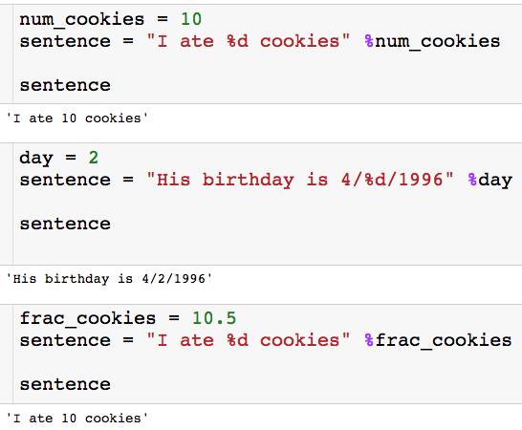
Formatting String - Integers

Slide 35
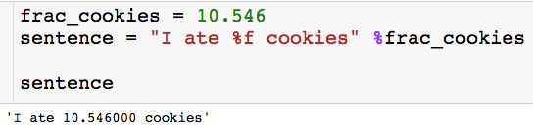
Formatting String - Floats
%f for inserting float (decimal)

Slide 36
Formatting String - Floats
%f for inserting float (decimal)
How do I control number of decimal points?

Slide 37
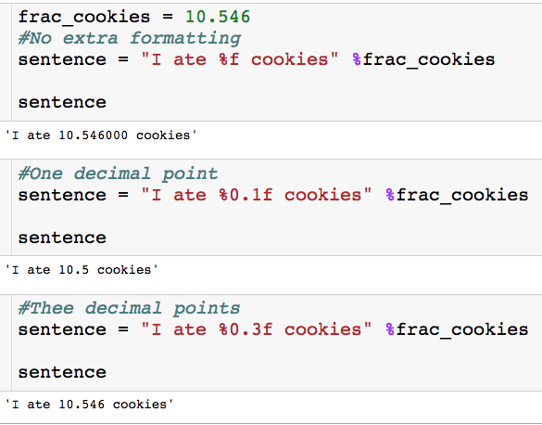
Formatting String - Floats

Slide 38
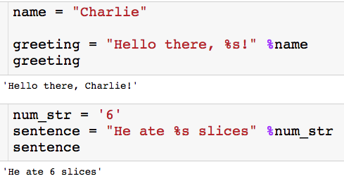
Formatting String - Strings

Slide 39

Formatting String - Strings
Hi!

Slide 40
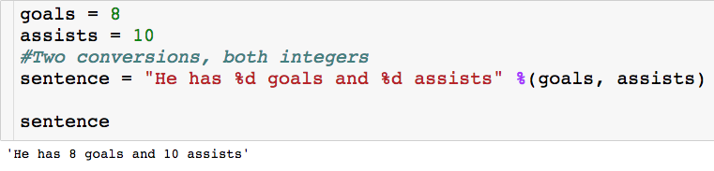
Formatting String- Multiple Replacements
Give variable names as a tuple
Order matters

Slide 41
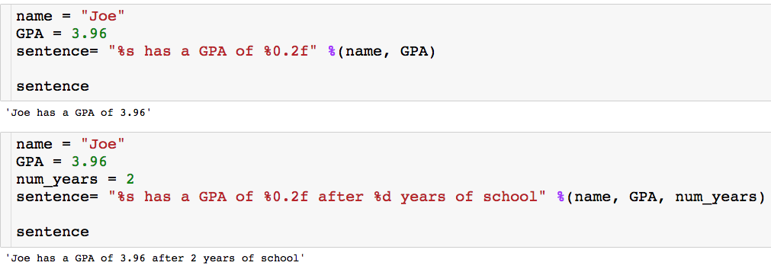
Formatting String- Multiple Replacements

Slide 42
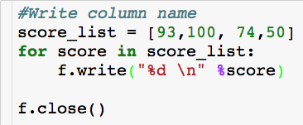
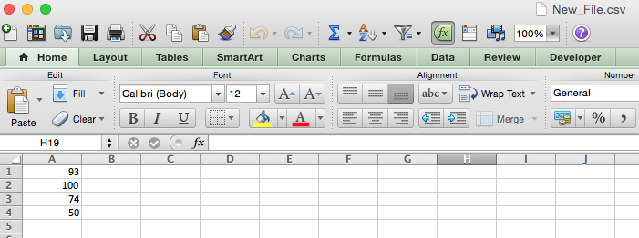
Back to Writing to Files

